Slide 1
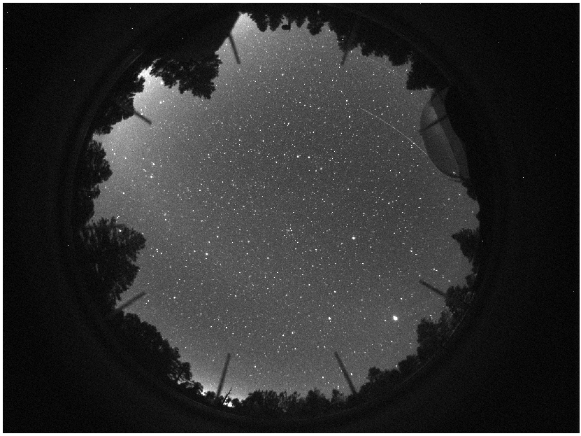
Cloud Finder: Automated Cloud Identification for Robotic Telescopes
Ryan Kelly
NAU Dept. of Physics and Astronomy
Mentor: Michael Mommert

Slide 2
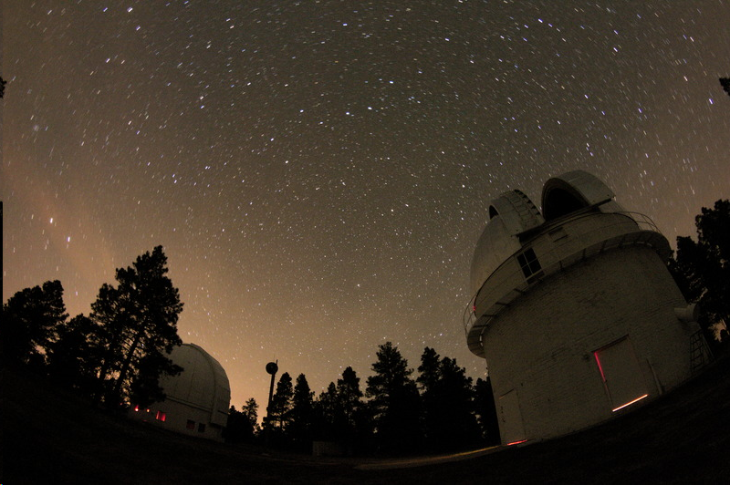
Introduction
Telescopes gather data about the universe.
Automated telescopes are susceptible to weather.
My project aims to make automated telescopes safer.

Slide 3
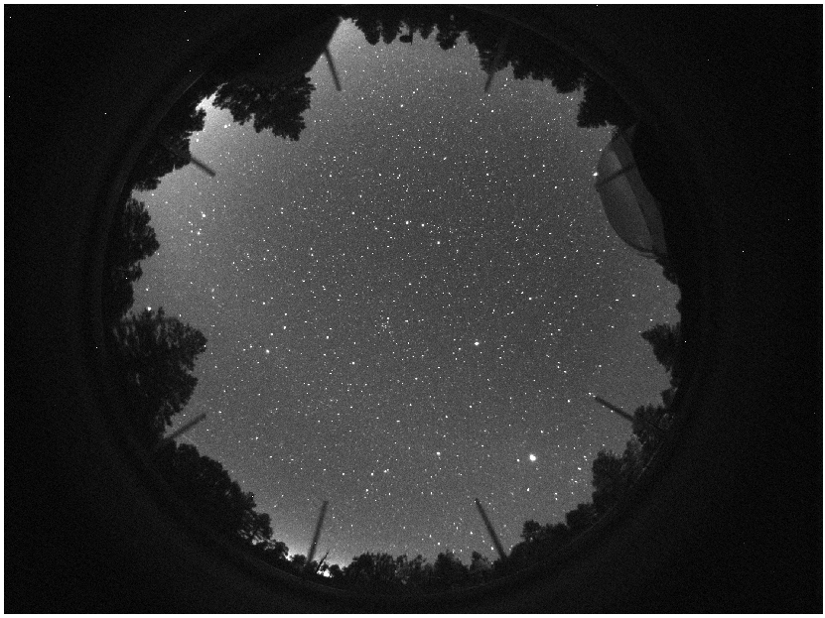
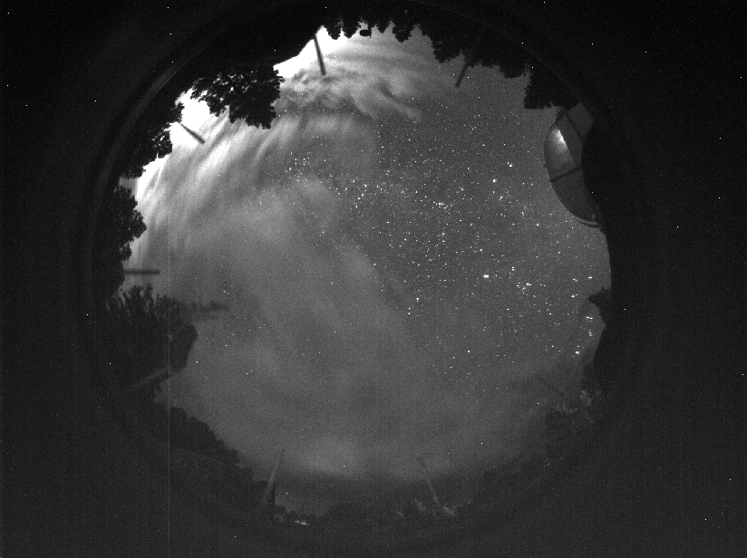
Allsky Camera Data
v

Slide 4
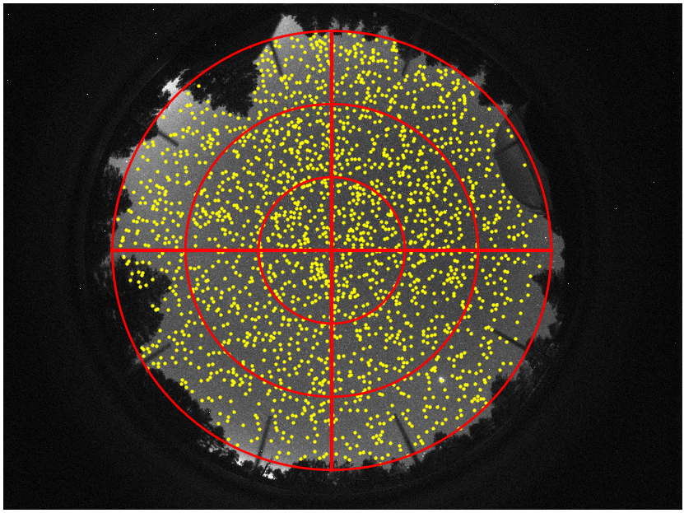
Data Processing - Feature Extraction
Identify Subregions
Star Count
Background Average Brightness
Time Derivatives
Manual Cloud Identification

Slide 5
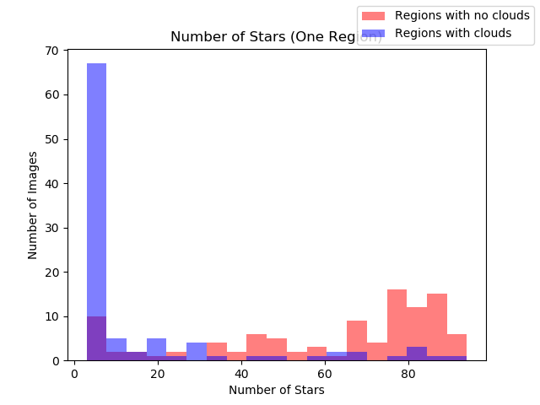
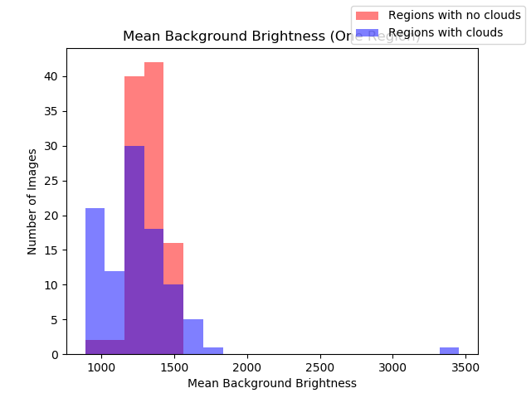
Analysis

Slide 6
Results
The algorithm is currently about 80% accurate at identifying a cloud within a given region.
With a little more tuning and data, this accuracy can be increased.

Slide 7
Future Possibilities/Improvements
Larger data samples / training sets.
Use an algorithm which detects the outlines of clouds.

Slide 8
Conclusion
We are able to roughly determine the location of clouds above an observatory, and thus the likeliness of precipitation, given a single allsky image.
We can then autonomously shut off automatic telescopes before there is any chance for weather to cause damage.

Slide 9




Questions and Recap
By collecting allsky images and identifying features from a given sample data set we can train a supervised machine learning algorithm to observe clouds. Then we use the algorithm to automatically warn telescope operators of the possibility of precipitation.
Acknowledgments:
Michael Mommert, Kathleen Stigmon, Nadine Barlow

